Slide 1
Accessing Computing Resources at TACC

Slide 2
Before the hackathon day
Please sign up for TACC user account at portal.tacc.utexas.edu and let us now your user account.
You will be added into a computing allocation on Frontera cluster at TACC. With the computing allocation, you can access Frontera computing nodes during the Hackathon
Data will be posted on a directory on Frontera system on Friday, April 23 at 7pm.
You are encouraged to use Frontera system throughout the hackathon. However, you are free to use your own resources as well.
Please do keep in mind your final code should be runnable on Frontera system.

Slide 3
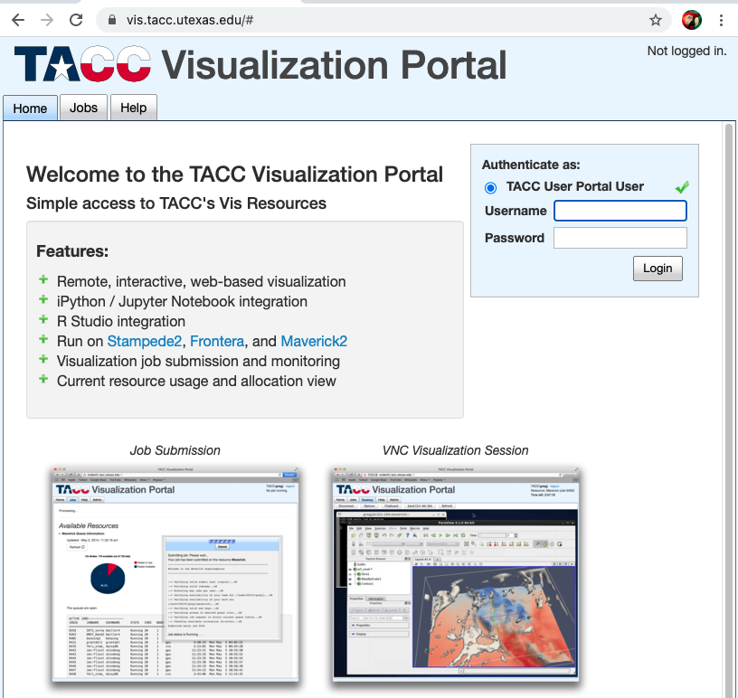
Using Jupyter Notebook on Frontera
A recommendation is to use Python for your Hackathon. Frontera provides support of Python 3.7 and Jupyter notebook.
To start a Jupyter notebook session, you can visit vis.tacc.utexas.edu and login with your TACC credential

Slide 4
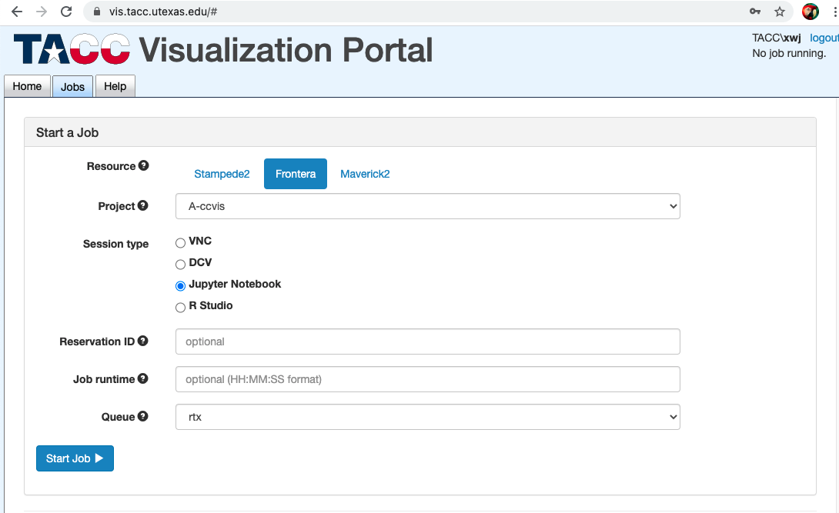
Running Jupyter Notebook from vis Portal
Upon logon, visit ‘Jobs’ tab
Choose ‘Frontera’ resoruces
Select “Jupyter Notebook” Session Type
Choose ‘RTX’ queue
Then “Start Job”

Slide 5
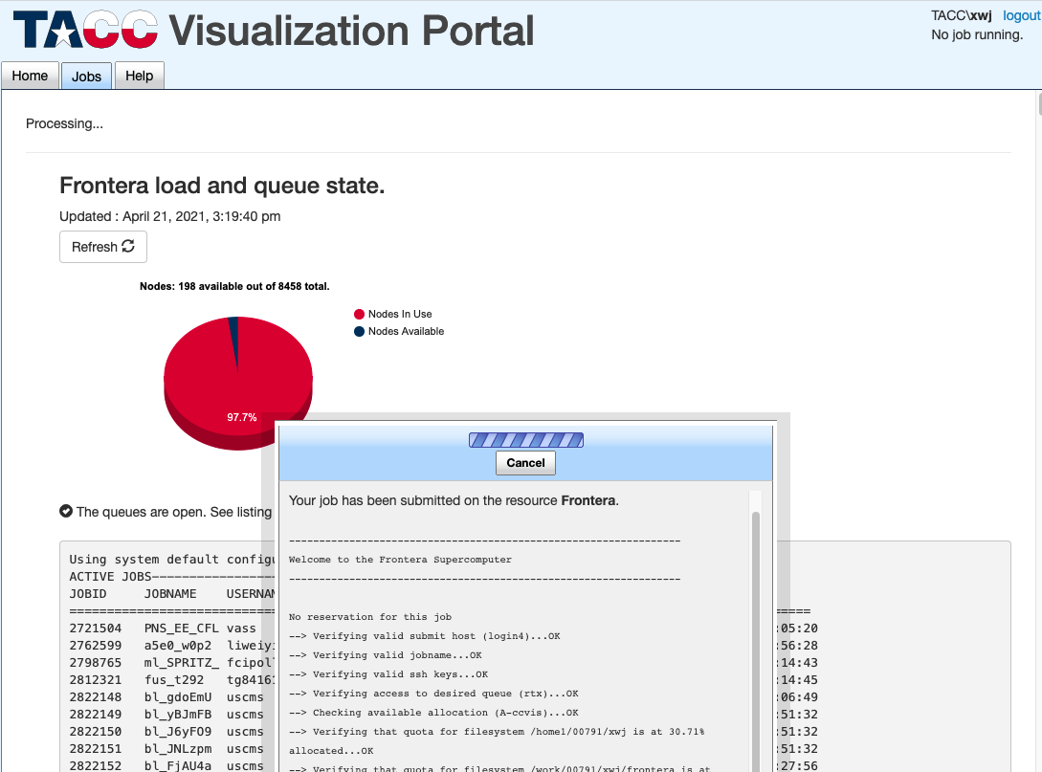
You should see a popup window showing your job has been submitted and queued.
Wait until this windows is gone.

Slide 6
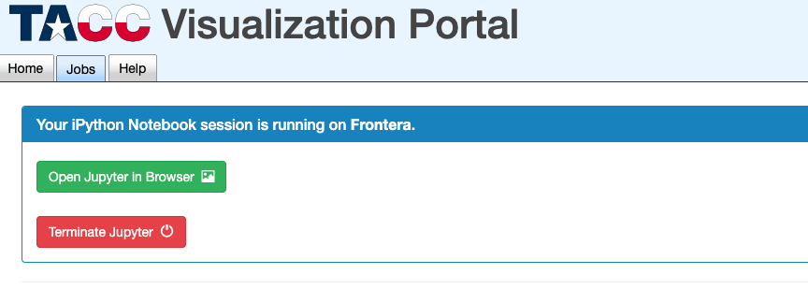
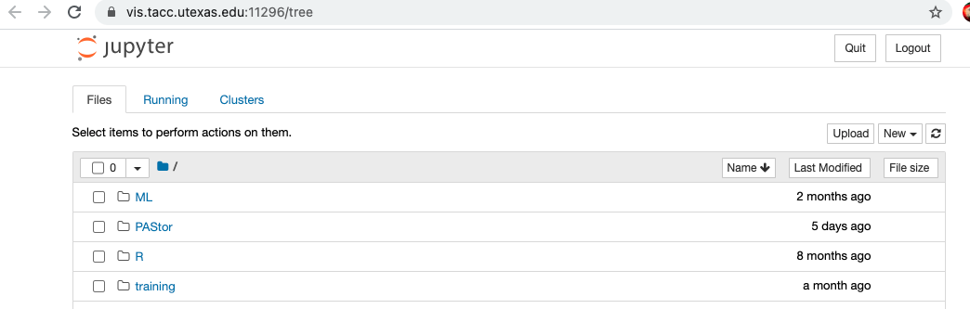
If your job has been successfully running, you should see buttons to open Jupyter Notebook sessions from your browsers.

Slide 7
Accessing Frontera node from Terminal
From a terminal window, run following command:
ssh username@frontera.tacc.utexas.edu
You will be asked for password and MFA token
You can setup MFA access through portal.tacc.utexas.edu
For detailed instruction see here
https://portal.tacc.utexas.edu/tutorials/multifactor-authentication
After logon, you will reach the login node of Frontera.

Slide 8
Running compute jobs
Please do not run computation jobs on login node directly, any job need to be run on compute node. There are two ways.
Via idev,
Idev is a script to submit an interactive job, you can start it by simply type in ‘idev’ in the terminal.
Upon running, you will log into a compute node. You can run computations through the terminal interactively from there.
For more information https://portal.tacc.utexas.edu/software/idev
Via sbatch
sbatch allow you to submit a script to compute node to run.
The script includes both computing job options and executable you wish to run. Please see here for an example job submission scripts. https://frontera-portal.tacc.utexas.edu/user-guide/scripts/
For more information visit https://frontera-portal.tacc.utexas.edu/user-guide/running/

Slide 9
Note
Running time, each job will run on compute node for a preset amount of time.
Idev, default is 30 mins, the value can be increased via –m options
Jupyter notebook, default is 2 hours, the value may be increased via time options.
Sbatch can run jobs for upto 48 hours, the value must be specified in the submission scripts.
Instructions and details will be posted on github pages on Friday.
If you plan to use any python packages, you can also install them via
pip install --user package_name

Slide 10
Please give a try to make sure you can access the system before 7PM Friday.
You can also review materials from our latest training,
Machine Learning at TACC, http://shorturl.at/kyQR7
Deep Learning at TACC, http://shorturl.at/bvwL0
Introduction to python and Jupyter notebook: http://shorturl.at/jIP37
A virtual office hour will be held via zoom between 5-6pm on Friday April 23 in case you have any problem and questions of accessing the system.

